Slide 1

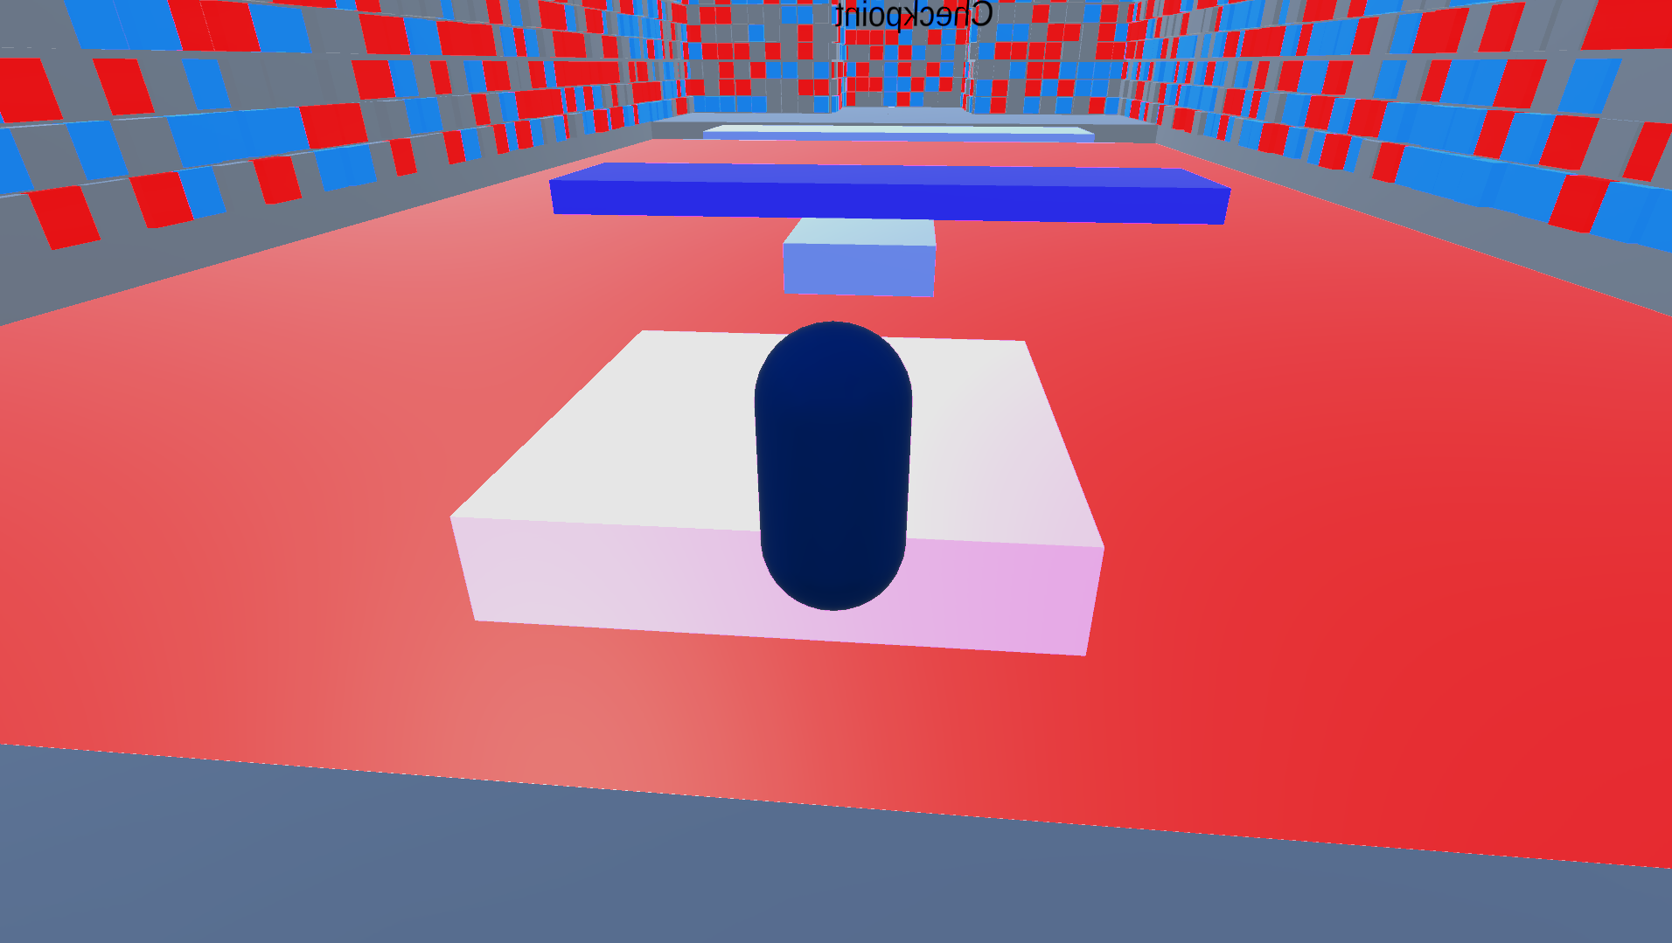

Master project session 2019-2021
Anthony Lamour
Notes:
Image Suzy Cube

Slide 2
Table of contents
Project Idea
Problematic and central questions
What is a template ?
What is an asset ?
What is Unity ?
Unity Asset Store
Unity publisher account
Unity Asset Store Tools
Few rules about Unity submission
How to create a package
How to send a package to a publisher account
Problems
The game
Conclusion

Slide 3
Project idea :
-Create the beginning of a Unity platform puzzle 3D template
-Create a short game that show what can be done with the assets

Slide 4
Problematic and central questions :
Create the beginning of a Unity game template accessible for users that do not know or know a little about programming.
Central questions :
How to create a Unity platform puzzle 3D template accessible for users that do not know or know a little about programming ?
How to show the features of the template ?

Slide 5
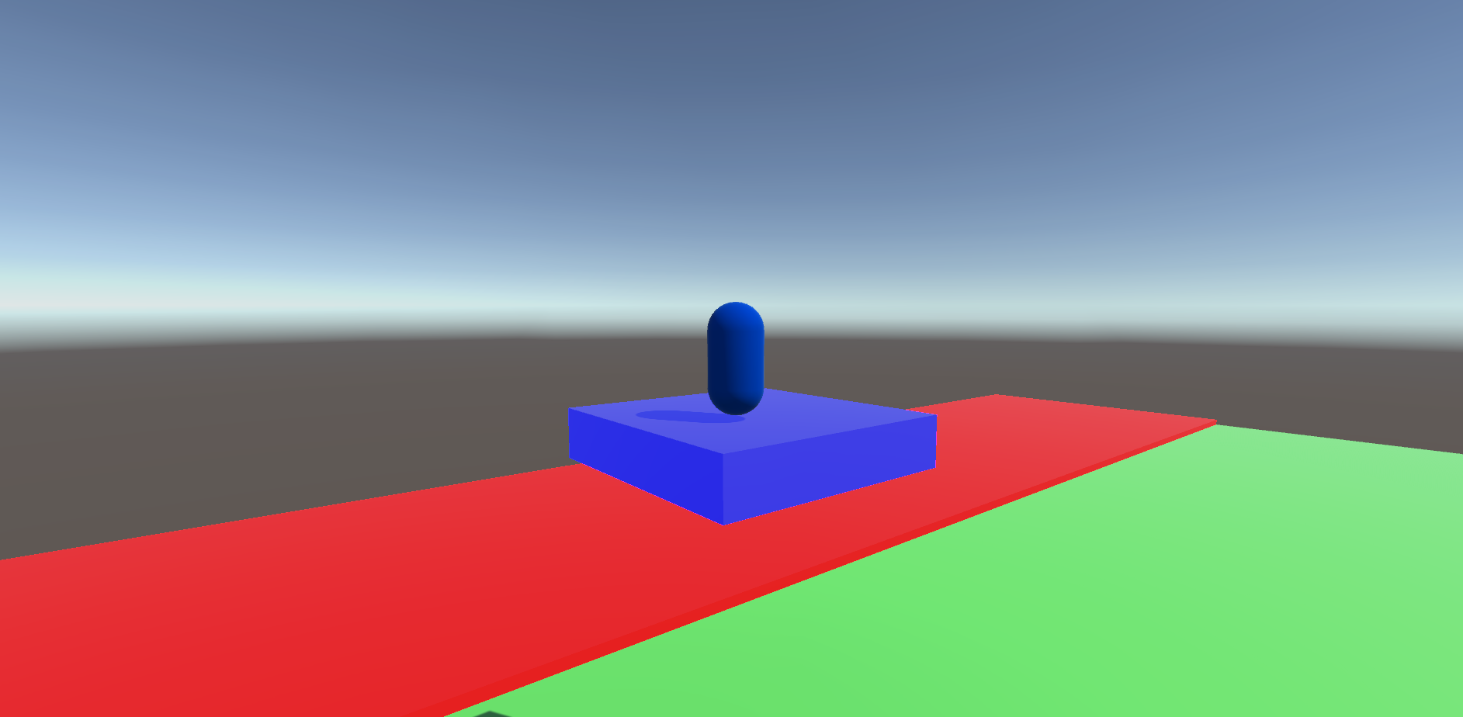
What is a template ?

Slide 6
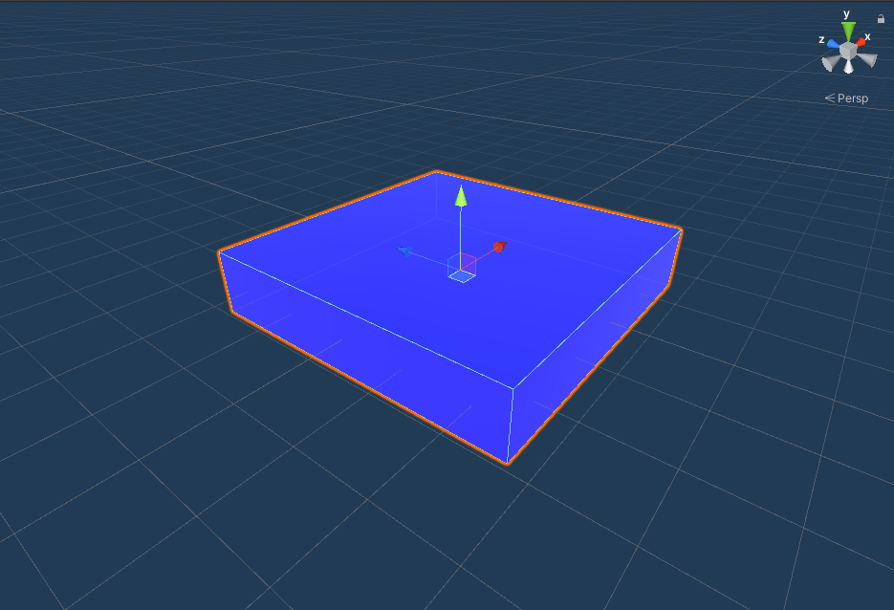
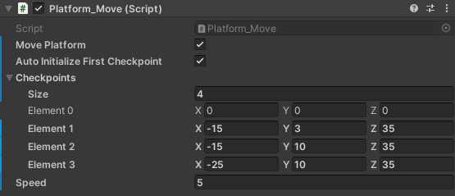
What is an asset ?

Slide 7
What is Unity ?

Slide 8

Unity Asset Store

Slide 9
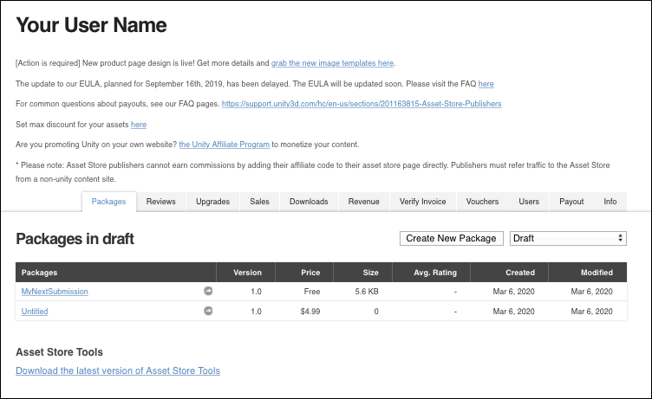
Unity publisher account

Slide 10

Unity Asset Store Tools

Slide 11
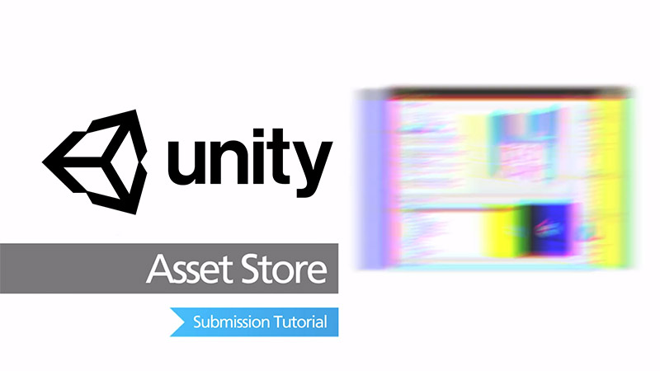
Few rules about Unity submission

Slide 12
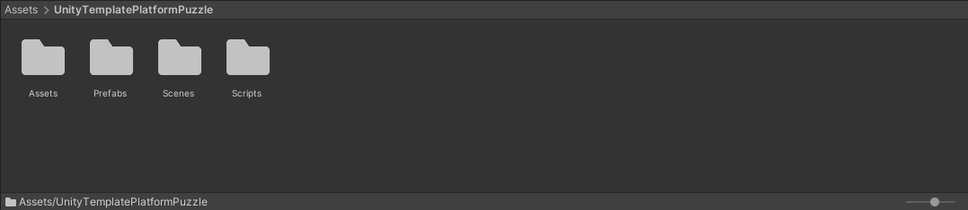
How to create a package ?

Slide 13
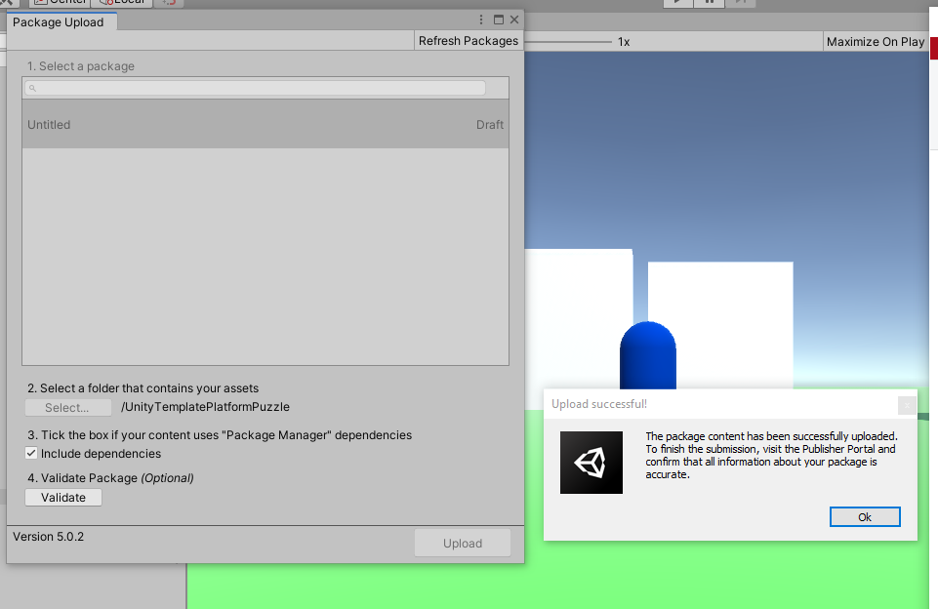
How to send the package to a Unity publisher account ?

Slide 14


Problems : first problem platform is too vague

Slide 15
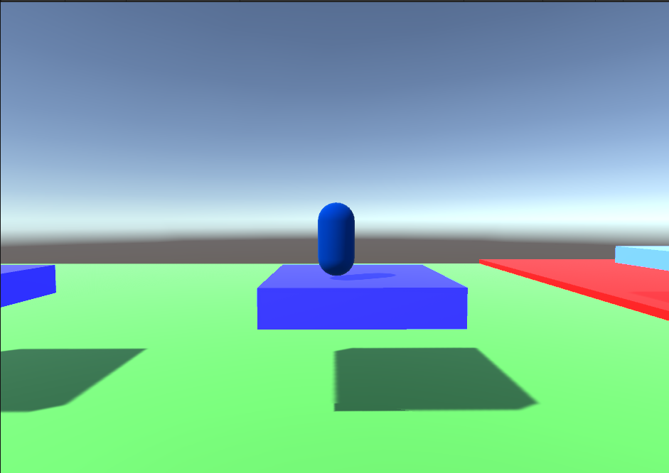
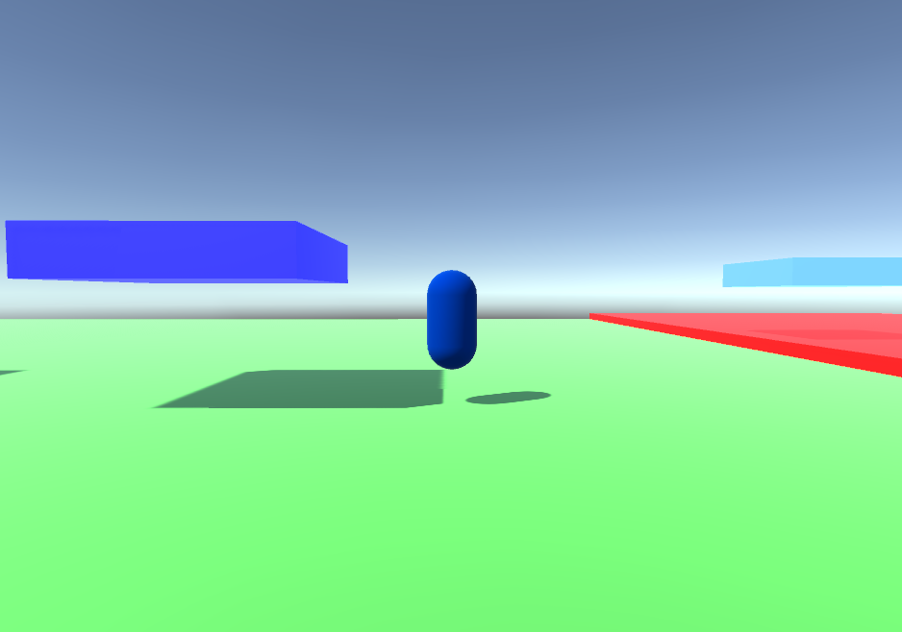
Problems : Moving platform but not player

Slide 16
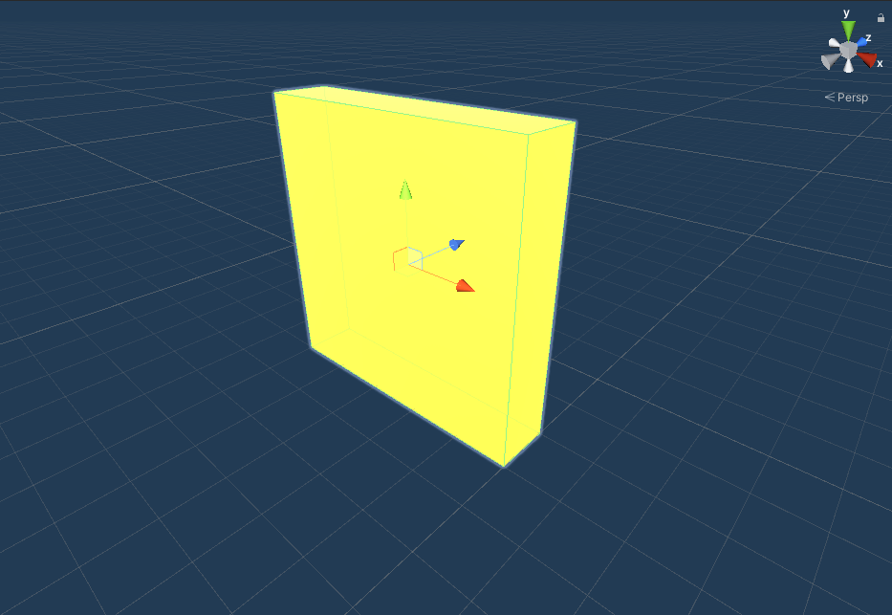
Problems : adding doors but…

Slide 17
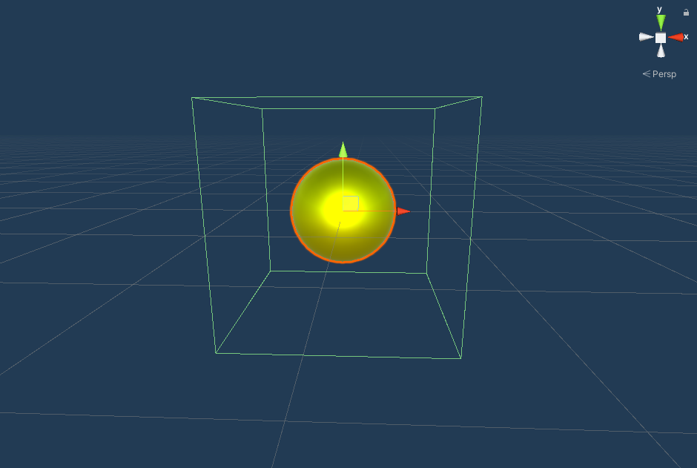
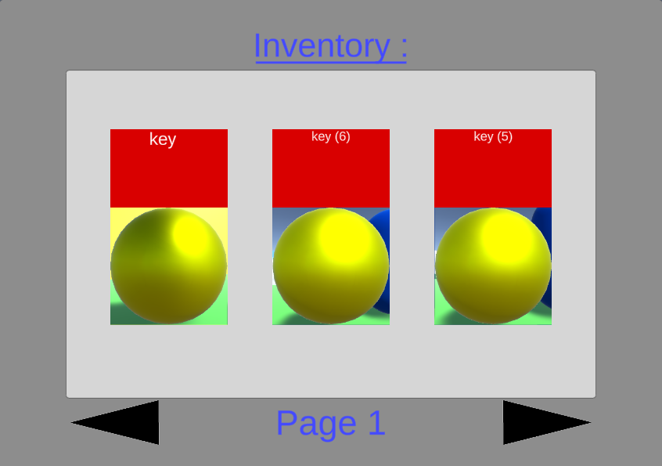
Keys = having an inventory

Slide 18
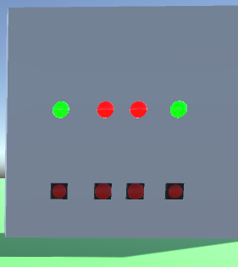
Problems : making a more puzzle way to open doors

Slide 19
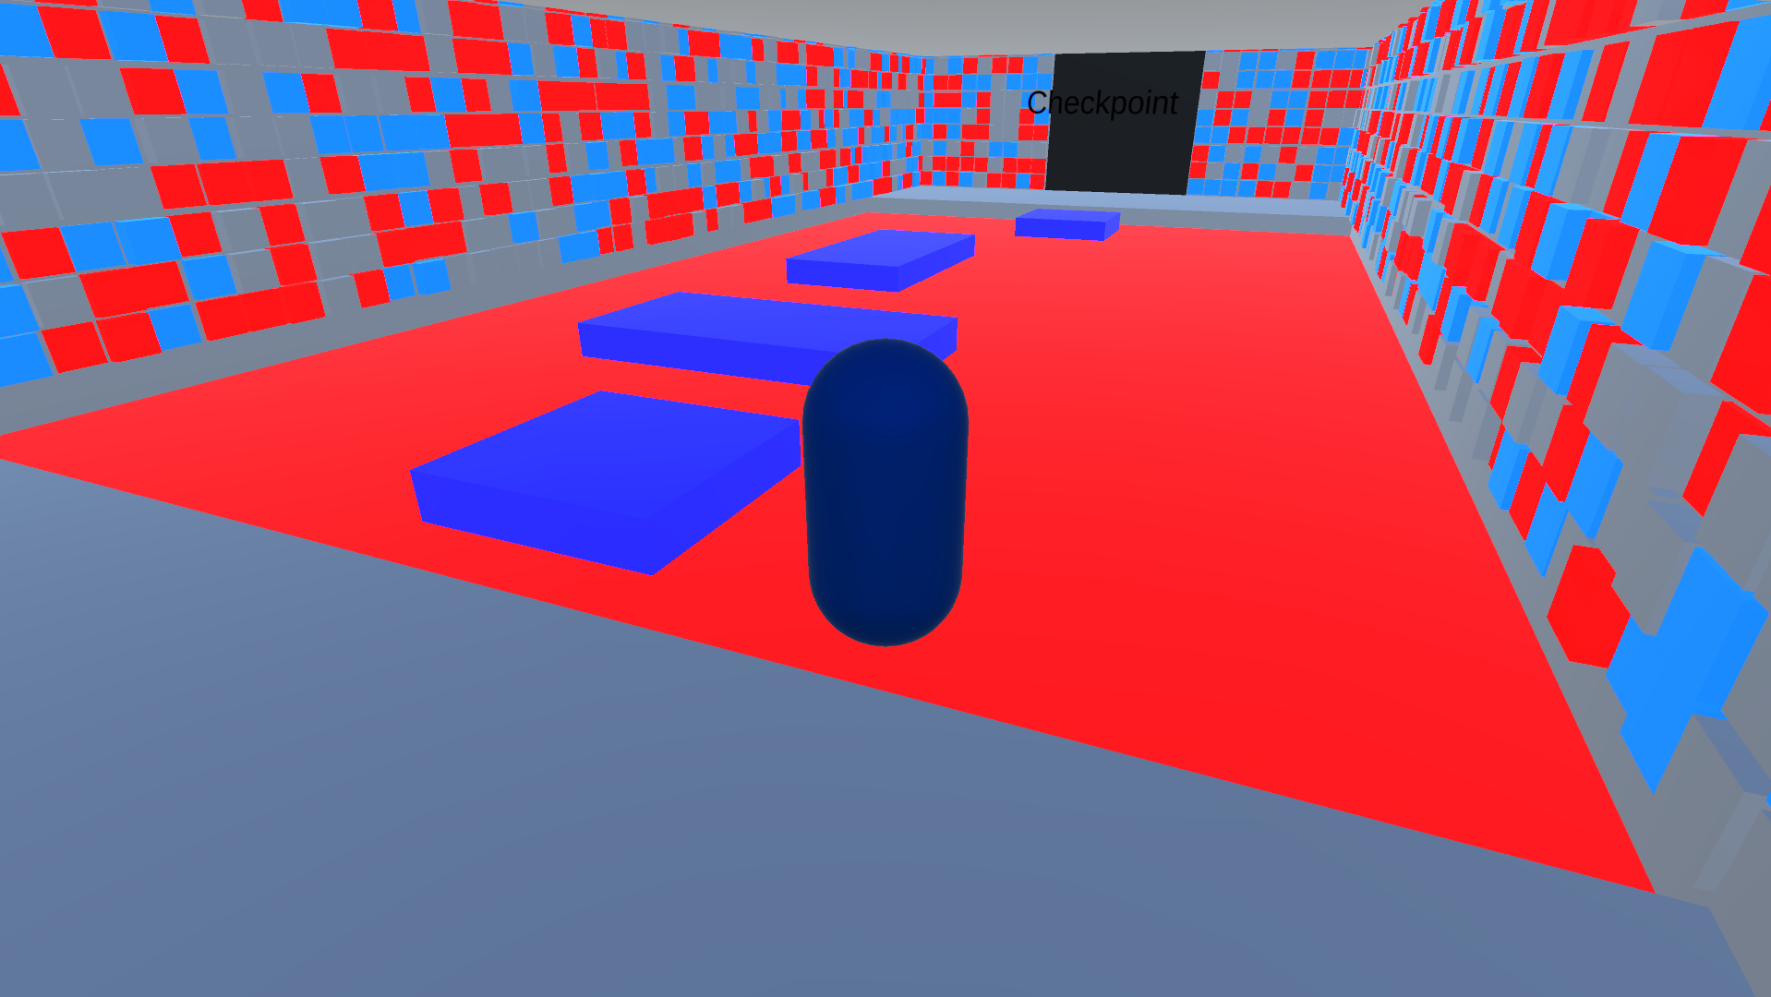
Problems : A full template too hard
Here comes the game

Slide 20
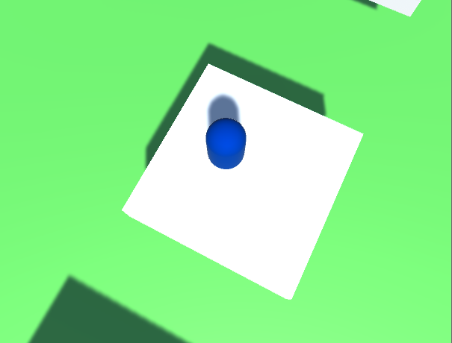
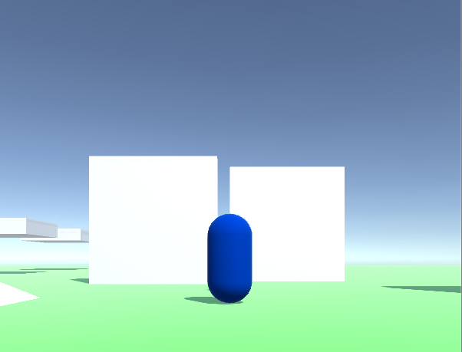
Problems : lack of feedbacks

Slide 21
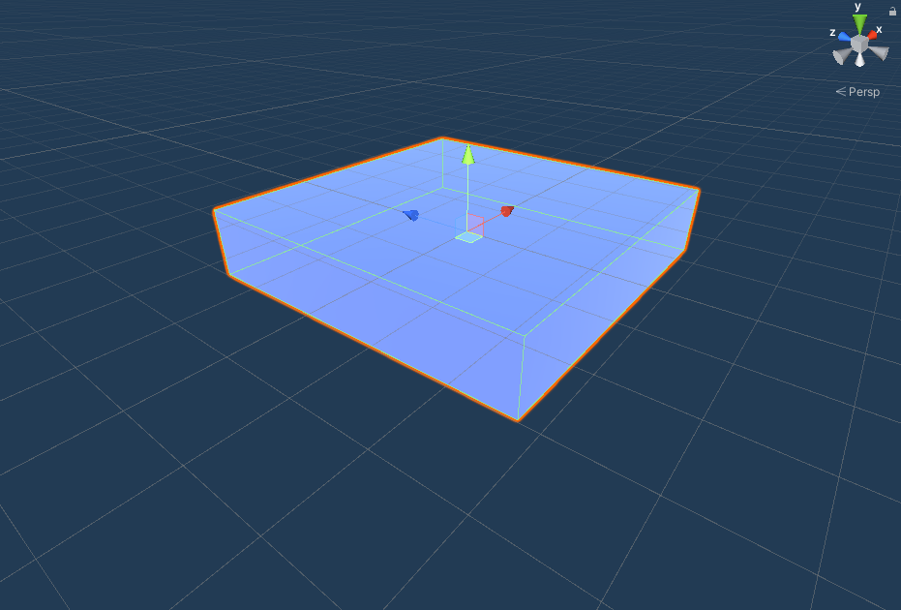
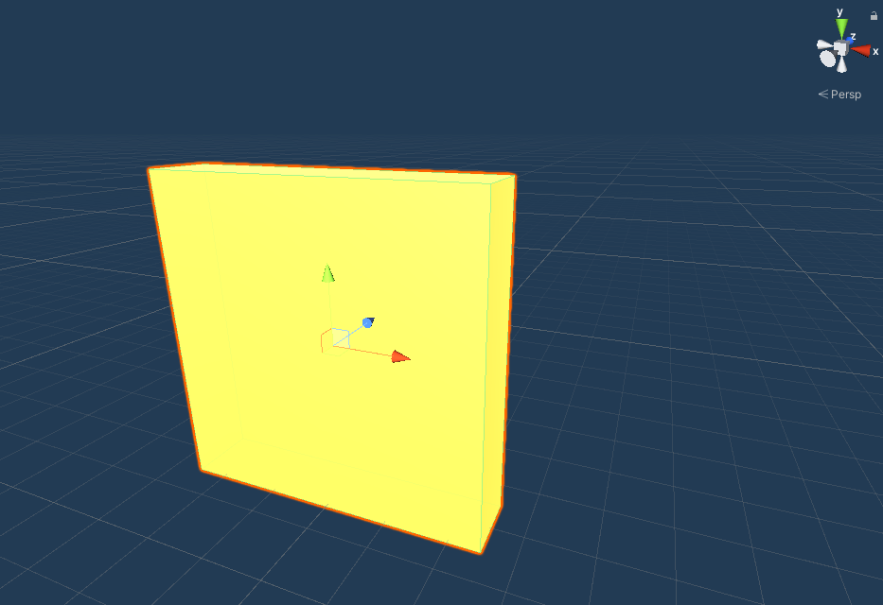
After materials

Slide 22
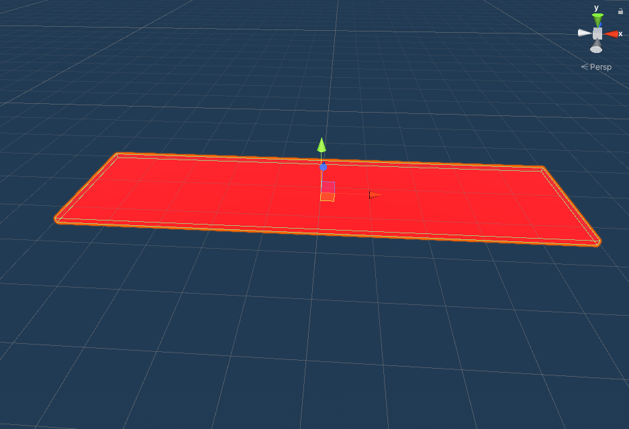
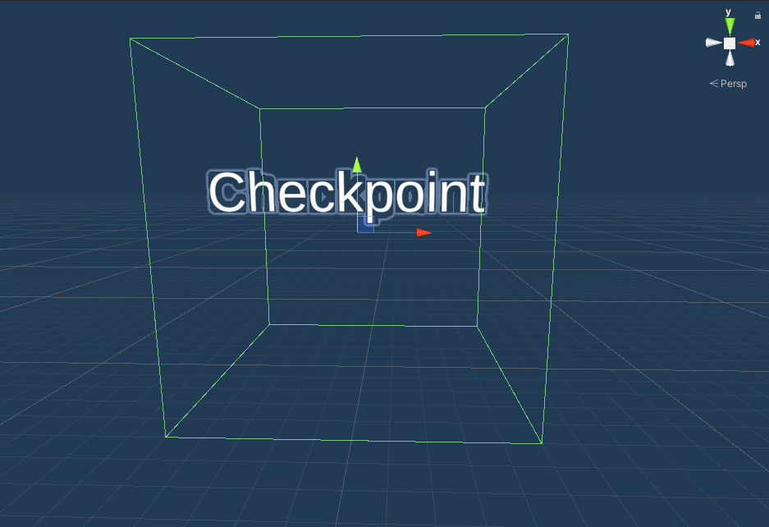
Problems : need a few more things

Slide 23
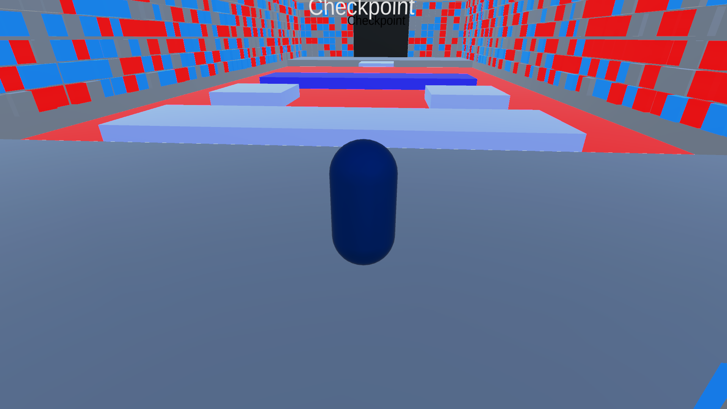
Problems : import

Slide 24

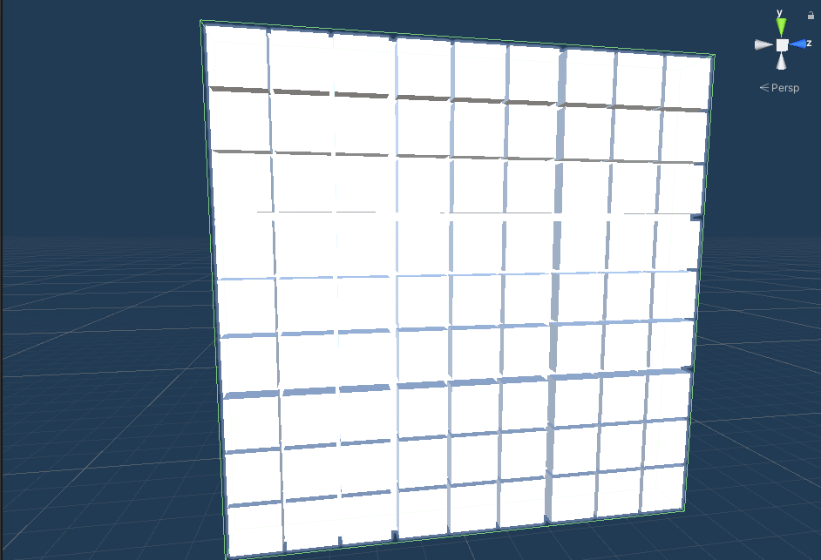
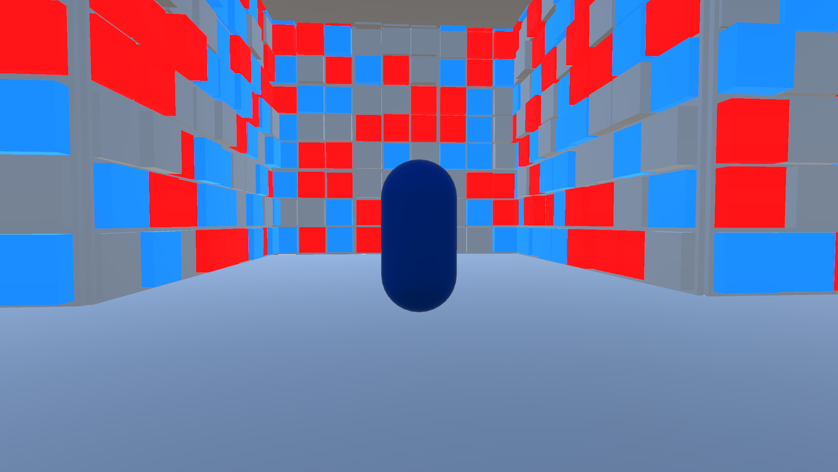
Problems : background

Slide 25
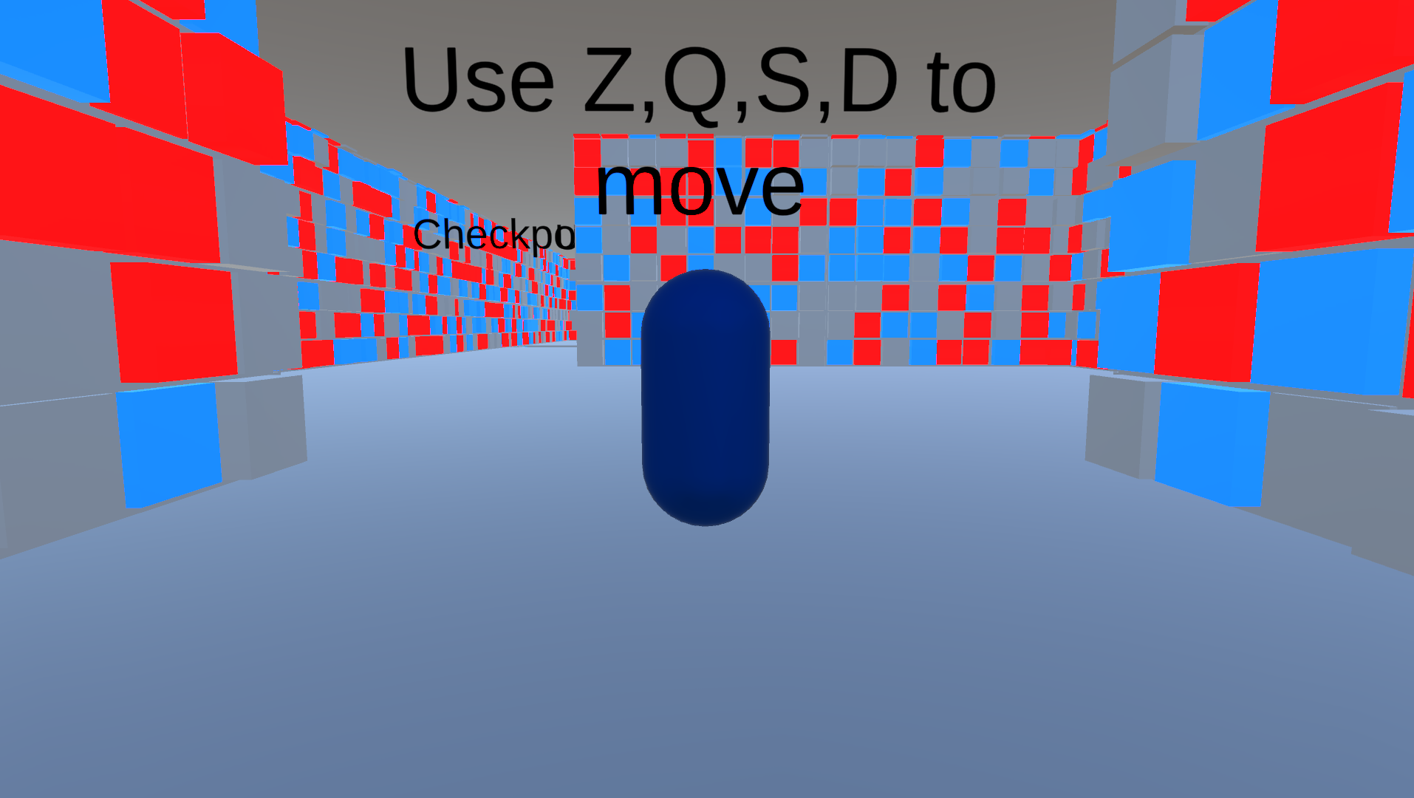
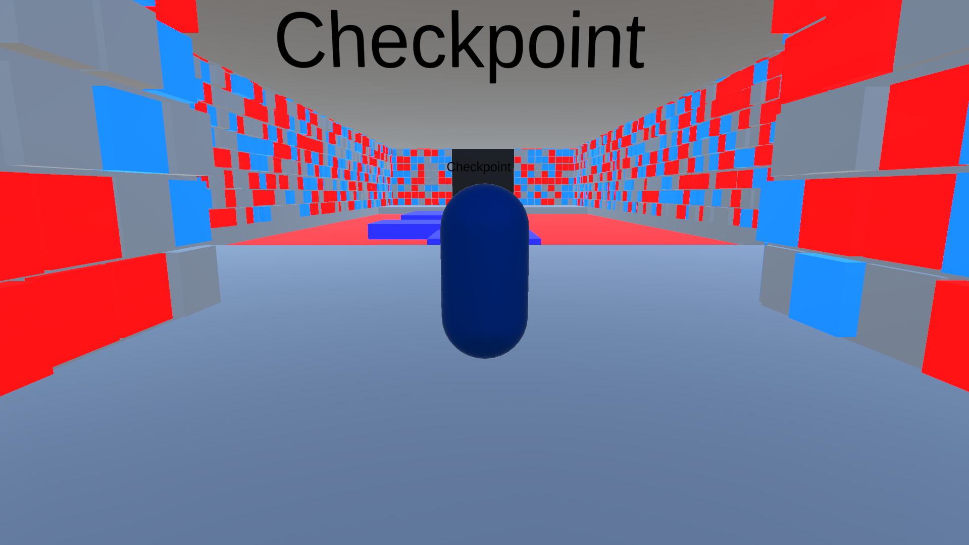
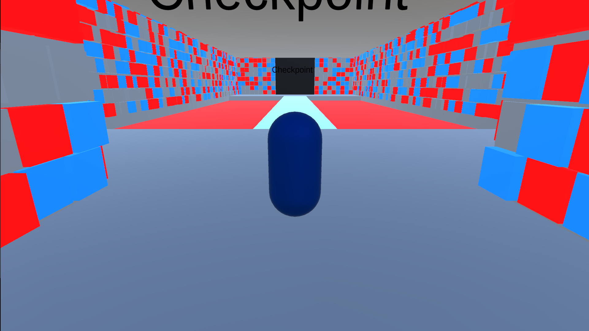
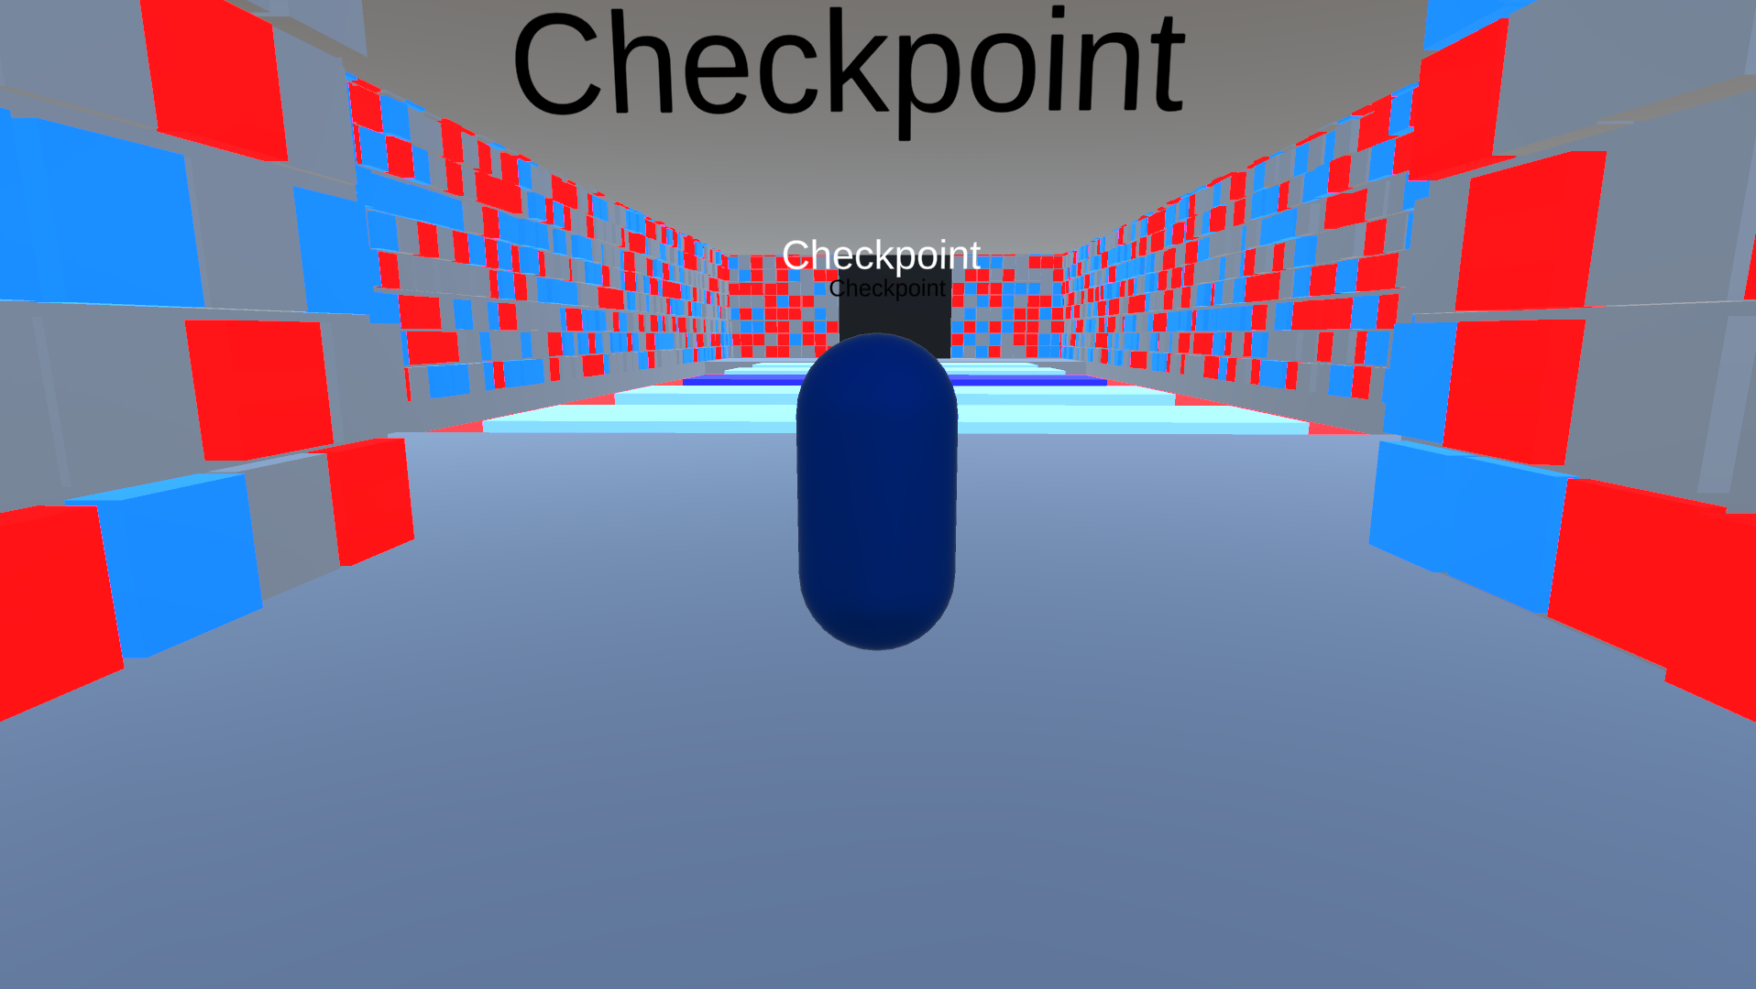
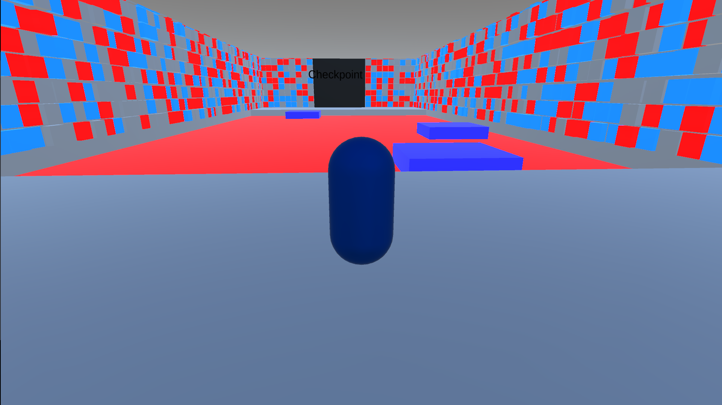
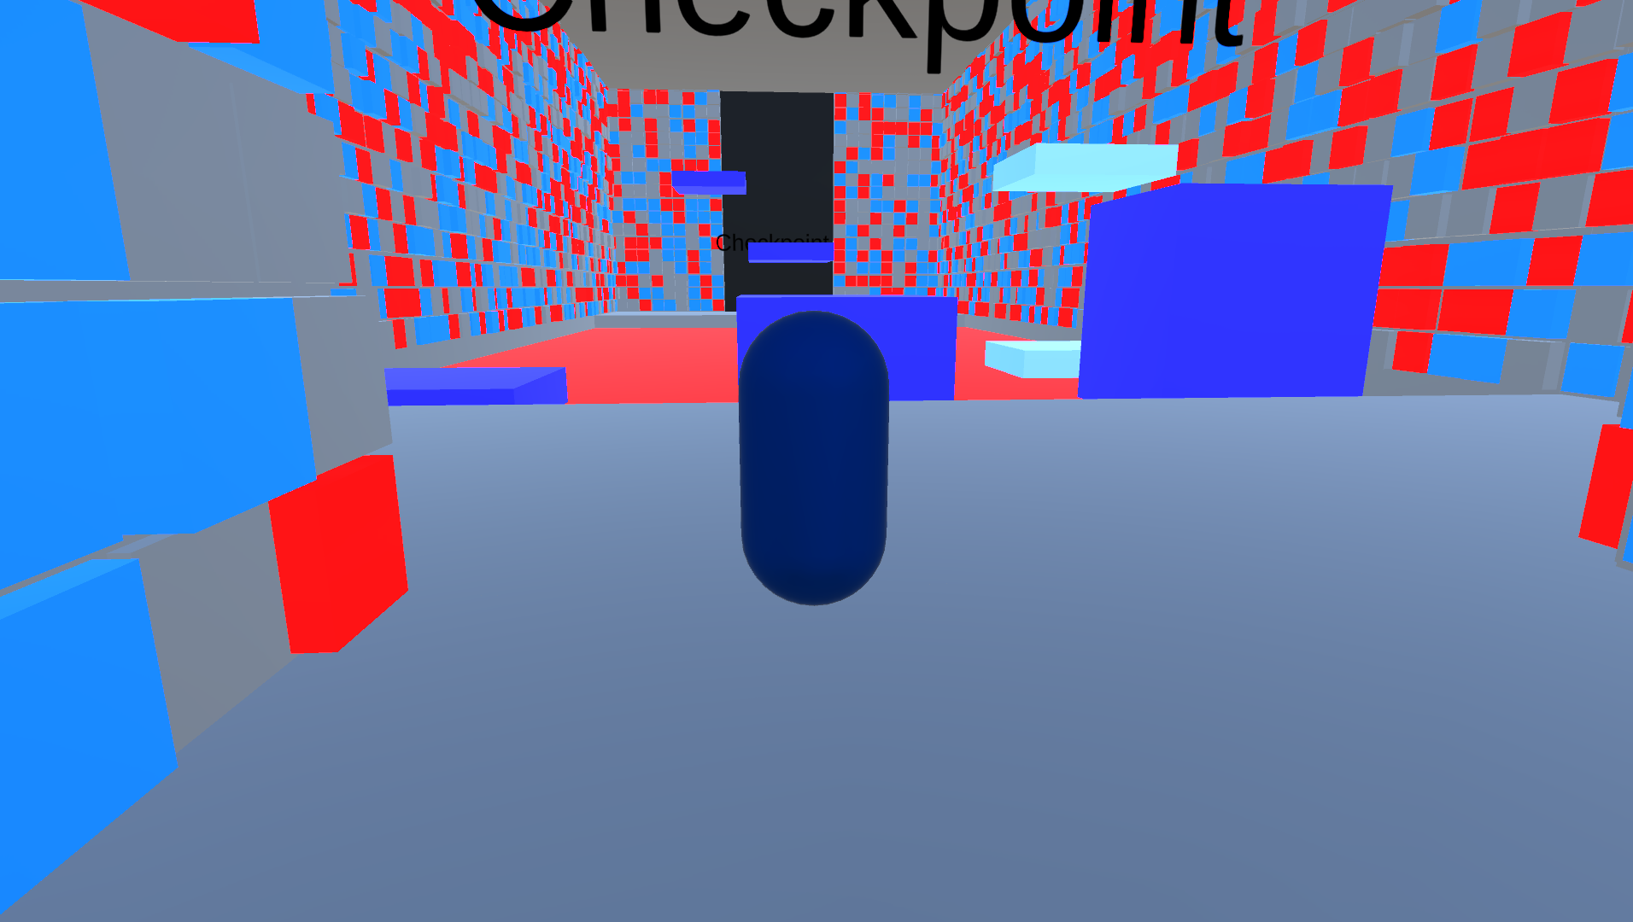
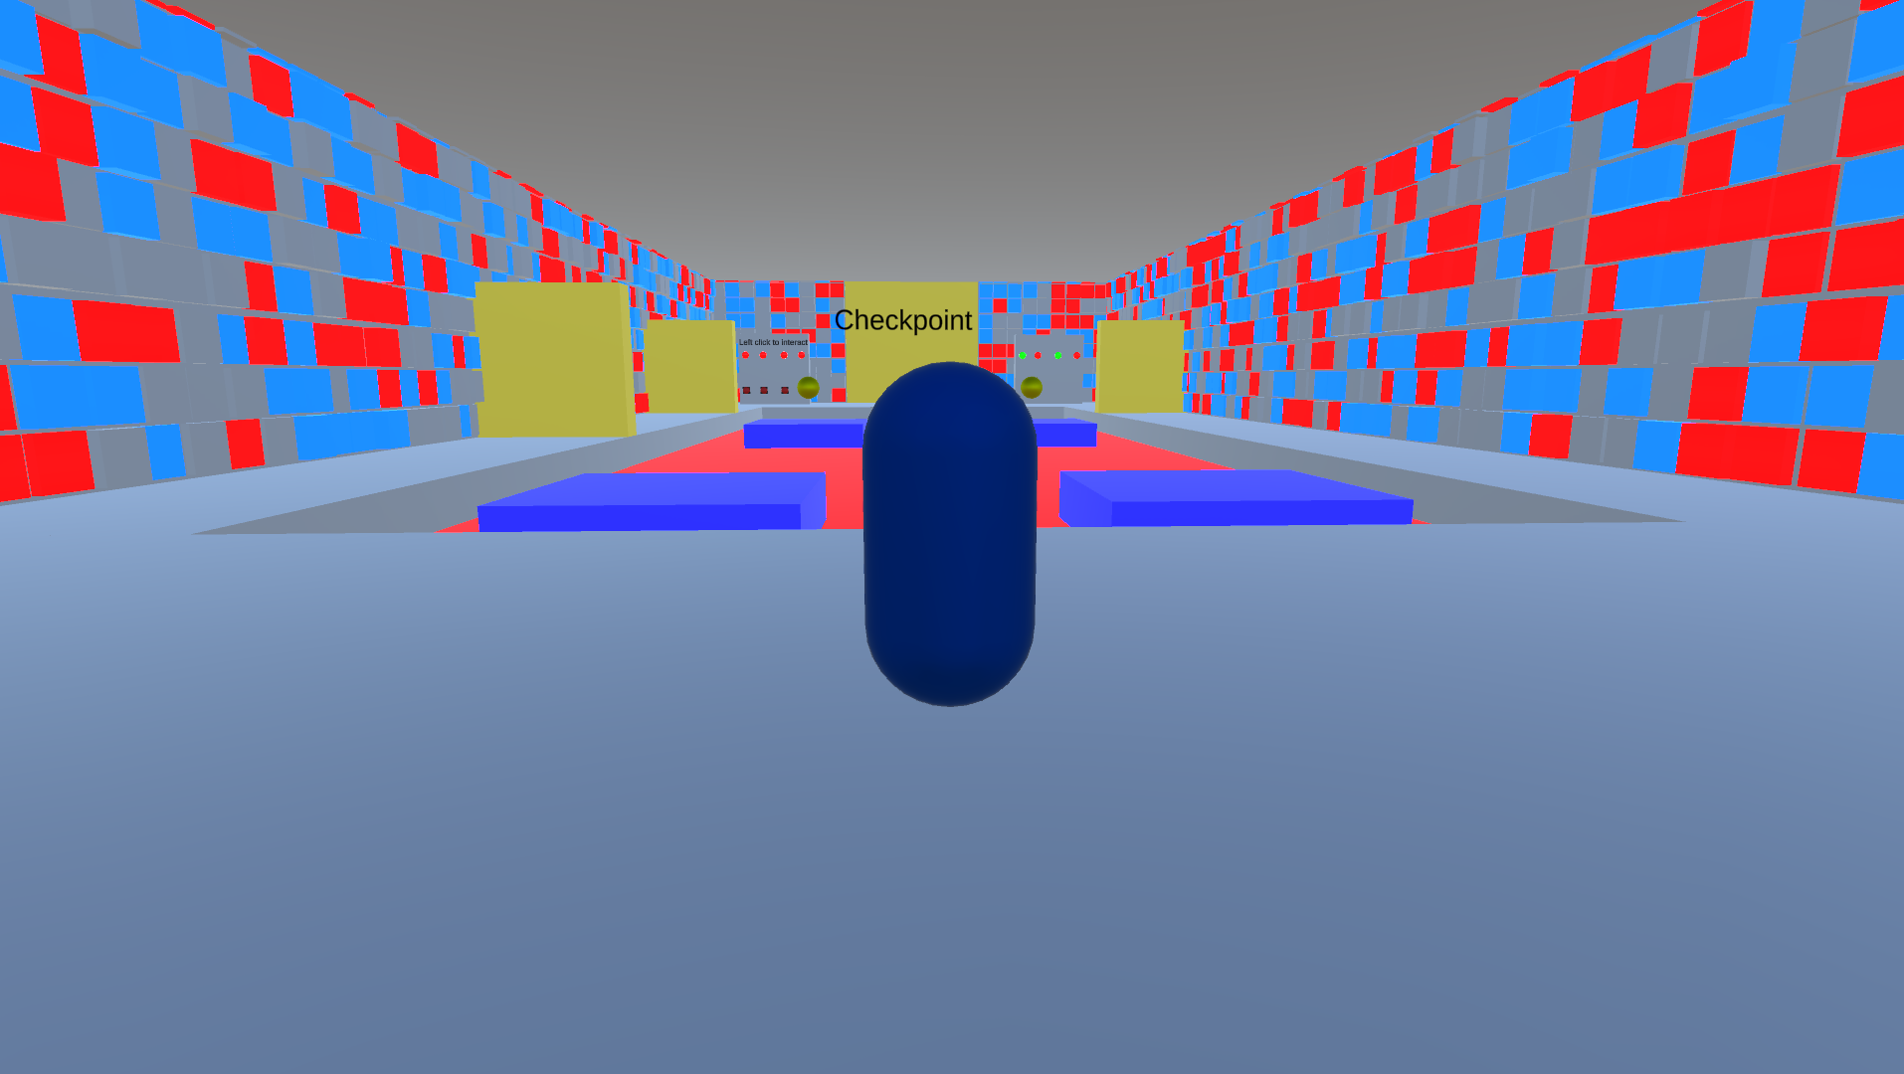
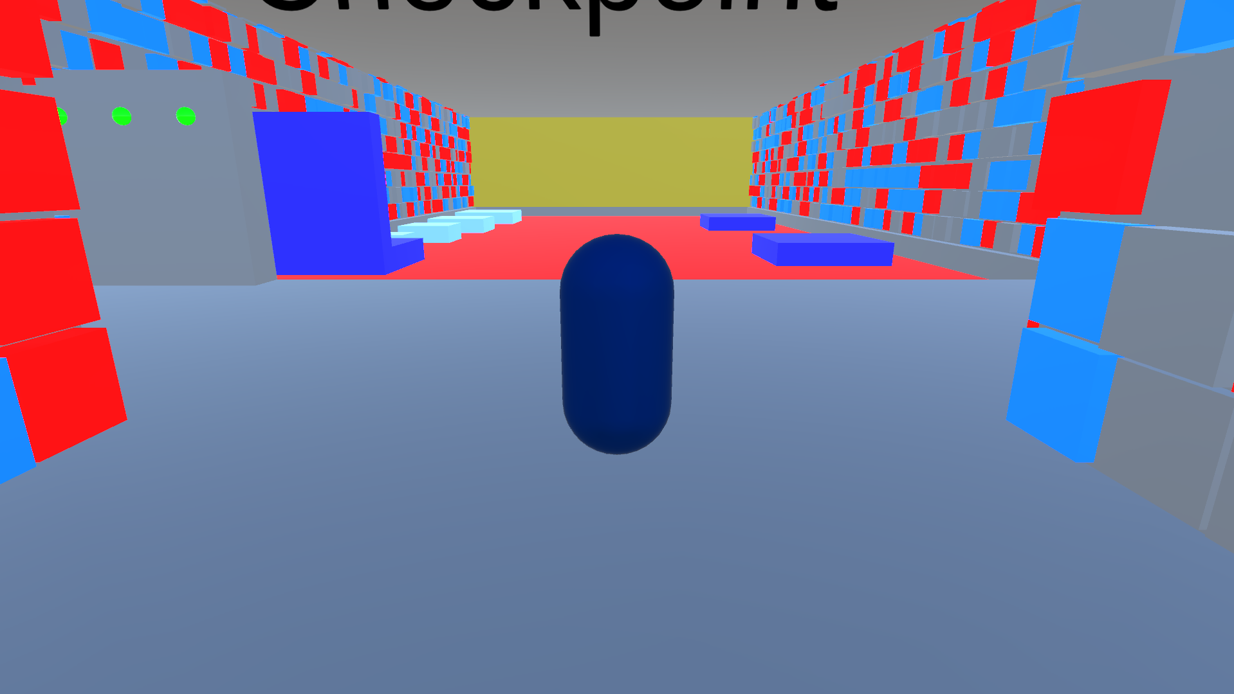
The game :

Slide 26
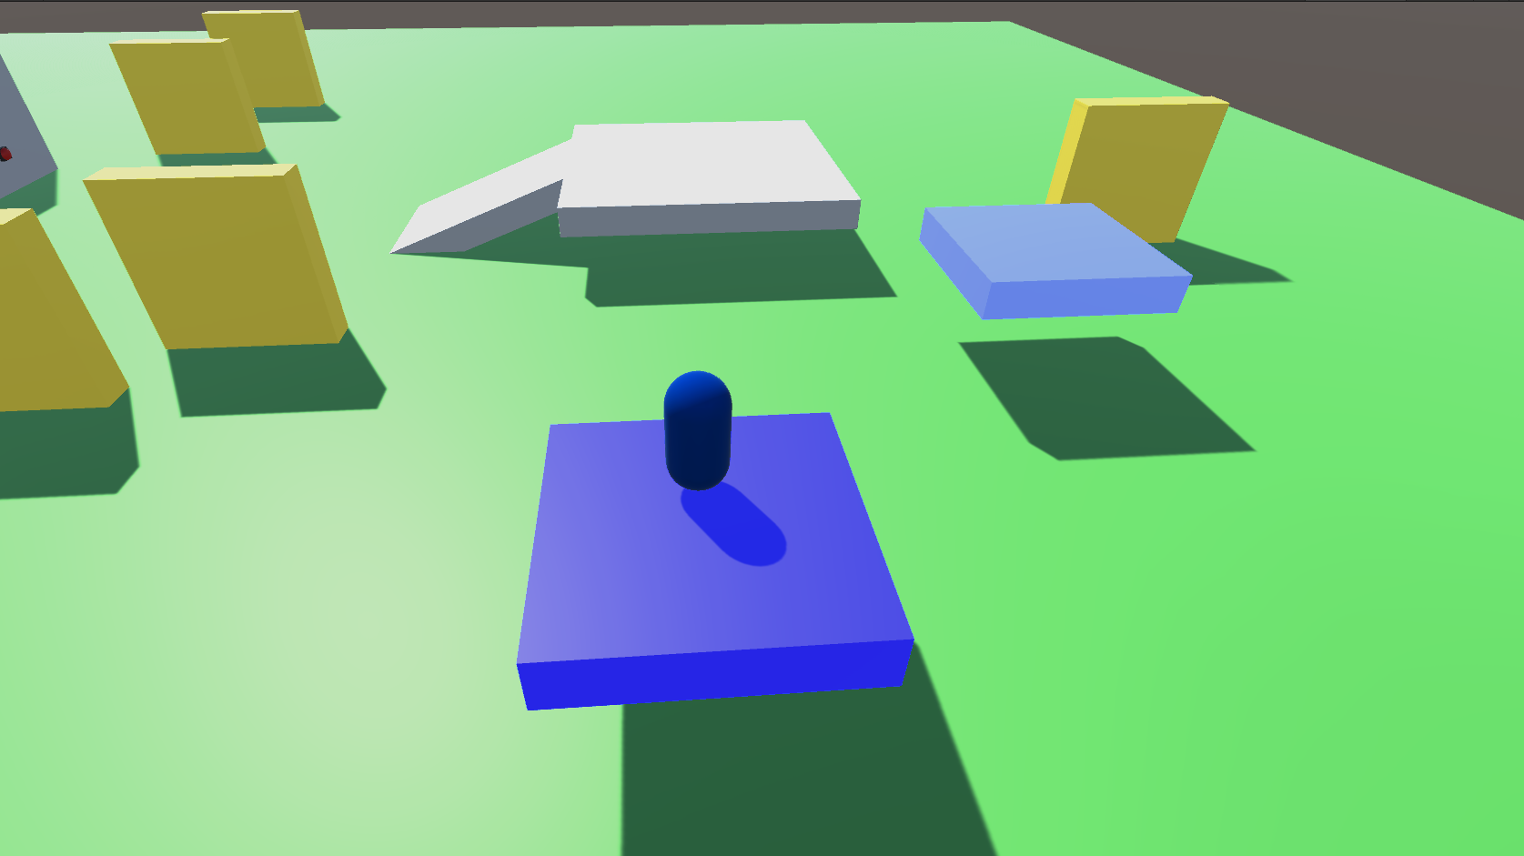
Conclusion :

